Slide 1
Web Scraping
Submitted by
Athira K.S

Slide 2
Introduction
Web scraping is a technique to fetch data from websites.
Web scraping is the process of collecting data from websites using automated scripts.
Web scraping allows you to acquire non-tabular or poorly structured data from websites and convert it into a usable, structured format.
Web scraping is done with the help of web scraping software known as web scrapers.
.

Slide 3
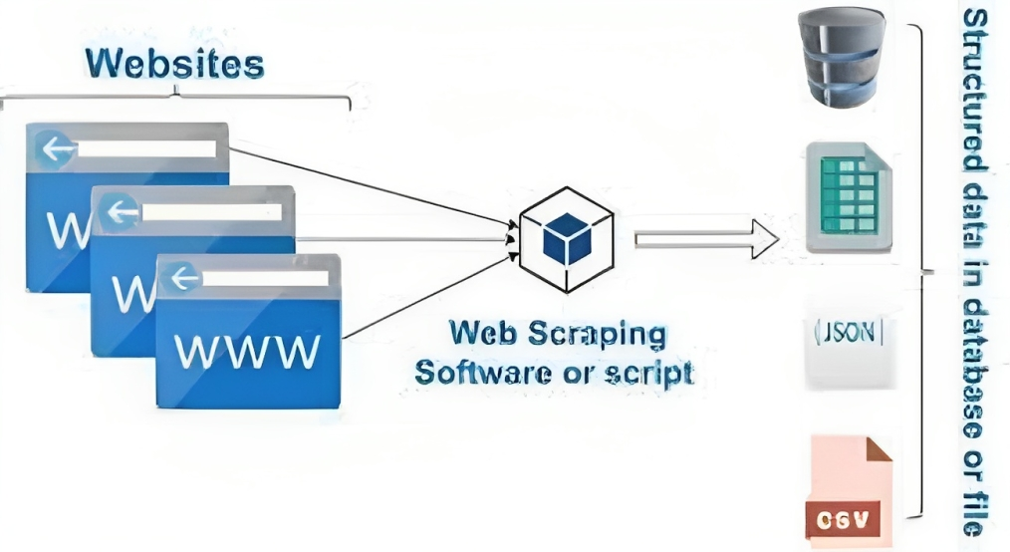
Architecture of web scraping

Slide 4
Web Scraping Frameworks
Beaufiful soup
Scrapy
Selenium
LXML
.

Slide 5
Beautiful Soup is a powerful Python library that simplifies web scraping tasks.
Efficiently parsing HTML and XML documents.
Providing user-friendly methods to search, navigate, and select elements within parsed content.
Working seamlessly with the requests library to fetch web content.
Creating a parse tree that enables easy navigation and extraction of desired information.
Saving time and effort in data extraction processess.
.
BeautifulSoup

Slide 6
Scrapy is a powerful and efficient Python framework designed specifically for large-scale web scraping tasks.
Organizing and streamlining complex data extraction processes.
Providing a structured approach using spiders to define website navigation and information extraction.
Supporting various output formats for extracted data (CSV, JSON, XML).
Delivering a robust and scalable solution for extracting data from complex websites
.
Scrapy

Slide 7
Use Cases of web scraping
E-commerce
News and Media
Price Intelligence
Job Boards
Market Analysis
Research
Natural Language Processing (NLP)
.

Slide 8
Advantages of web scraping
Cost-effectiveness
Speed
Scalability
Improved decision-making
.

Slide 9
Disadvantages of web scraping
Data analysis
Difficulty for non-tech users
Speed and protection policies
Privacy and security risks
Resource-intensive and scalability challenges
.

Slide 10
Web scraping is a powerful method for obtaining information from websites.
It provides a cost-effective and time-saving way to gather large amounts of data.
It is important to carefully consider the legal and ethical implications of web scraping, as well as the potential technical challenges and variability of websites.
It is important to be mindful of the privacy risks and legal considerations associated with web scraping and to ensure that the activities are conducted in a legal, ethical, and respectful manner.
.
Conclusion

Slide 11
Thank You

